Slide 1



VIPERlib
Supervised by: Jasmine DeHart
Lab Advisor: Christan Grant
OU Data Lab
An open-source Python Library for mitigating privacy with Machine Learning

Slide 2
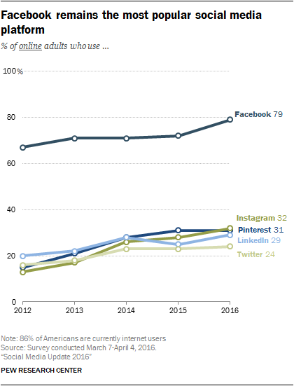
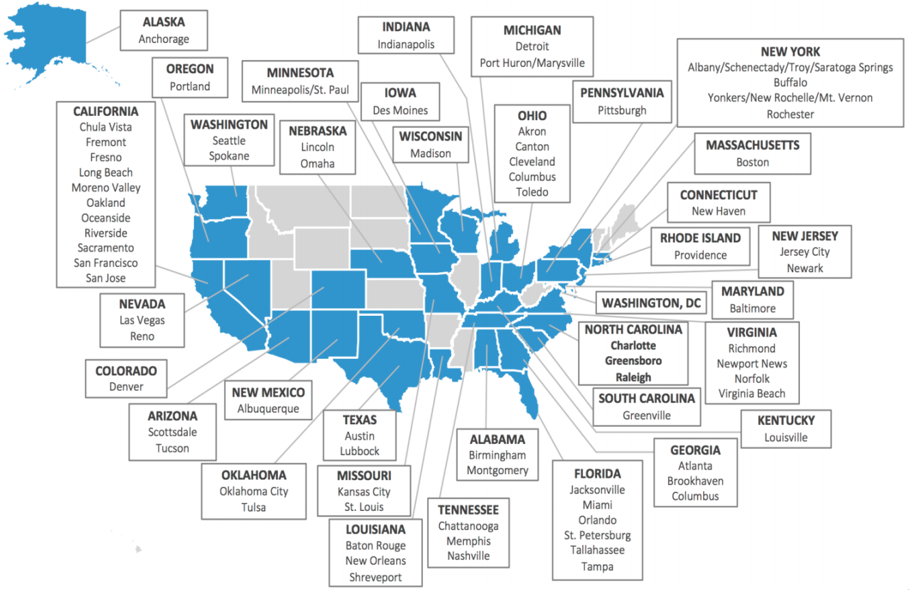
Overview
Greenwood, S., Perrin, A., & Duggan, M. (2016). Social media update 2016. Pew Research Center, 11, 83.
Notes:
How pervasive are privacy leaks in datasets and connected environments?
What reasonable techniques can be built to decrease the amount of privacy leaks?

Slide 3
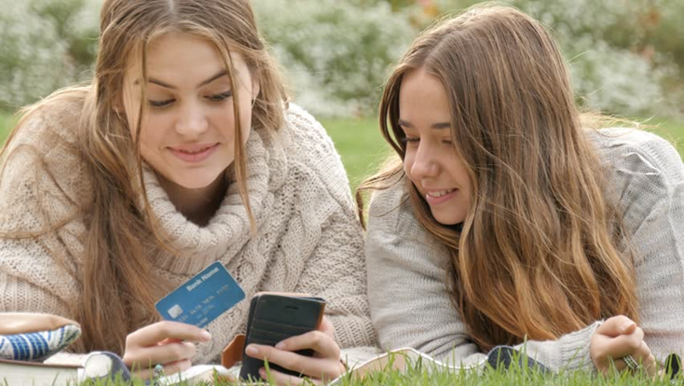
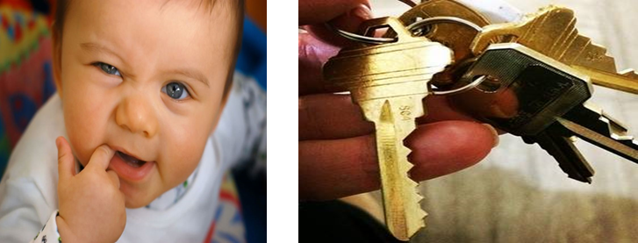
Examples
Greenwood, S., Perrin, A., & Duggan, M. (2016). Social media update 2016. Pew Research Center, 11, 83.

Slide 4
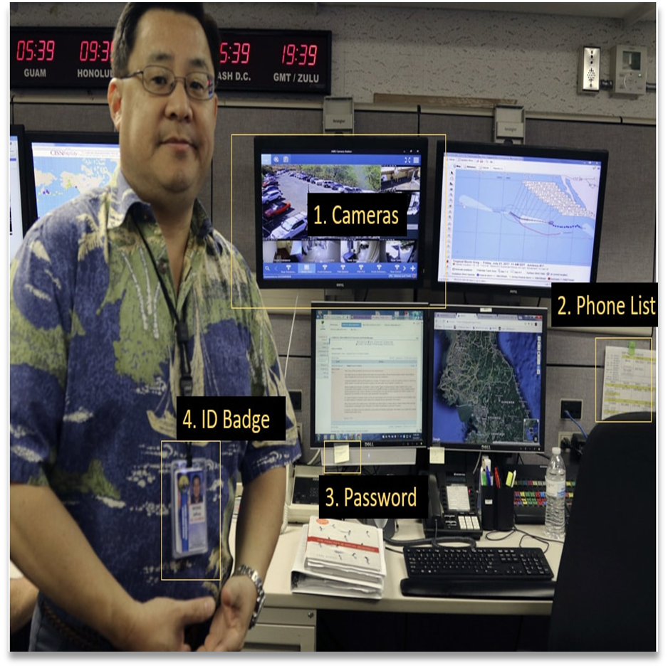
Visual Privacy Leak Example Hawaii Emergency Agency source: Twitter
M. Henriksen, January 2018.

Slide 5

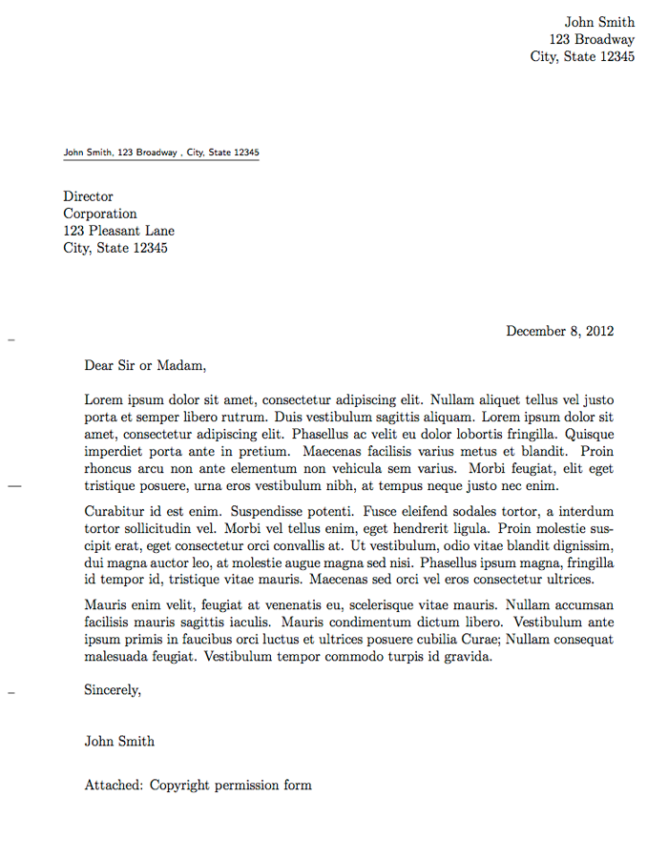
Location
Dangers:
Burglary
Stalking
Kidnapping
Notes:
An attacker can use this opening to exploit your residence or current location.

Slide 6

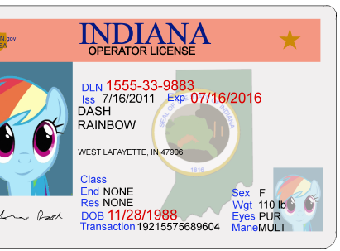
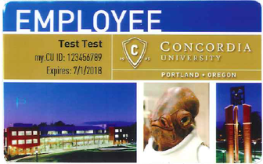
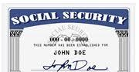
Identity
Dangers:
Identity theft
Financial threat
Burglary
Notes:
An attacker can use this opening to exploit your identity.

Slide 7

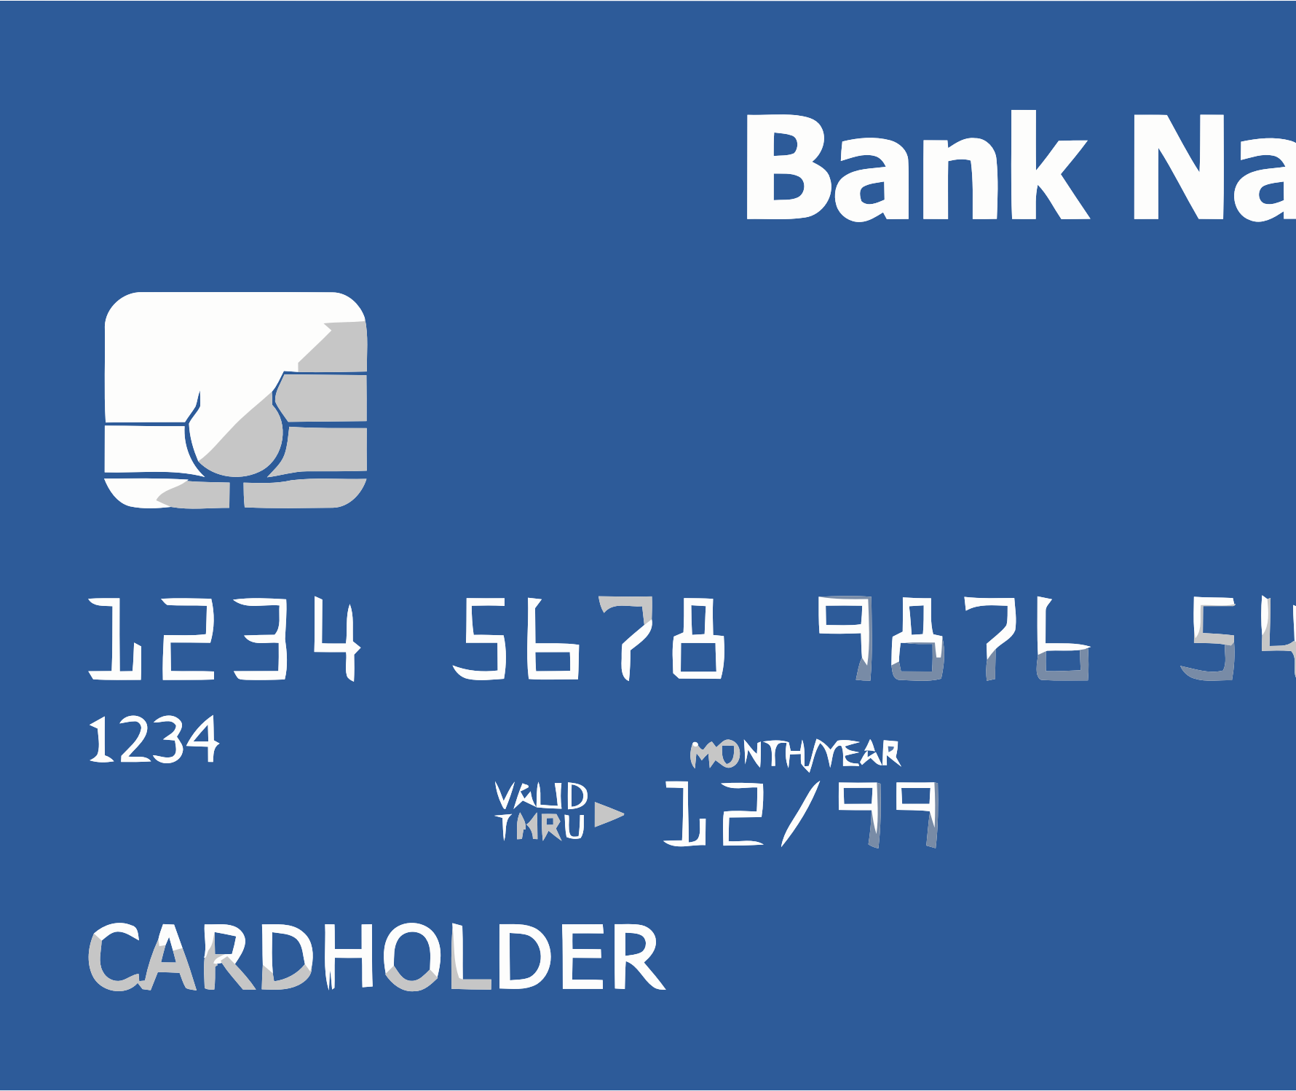


Asset
Dangers:
Financial threat
Burglary
Digital kidnapping
Explicit websites
Notes:
An attacker can use this opening to exploit your possessions and valuables.

Slide 8
WHAT IS VIPER?
VIPER is the Visual Inspection of Personally Exposed Records
Understand perspectives of private content
Propose mitigation techniques and libraries
Research privacy in the domains of social media, smart cities, and connected networks

Slide 9
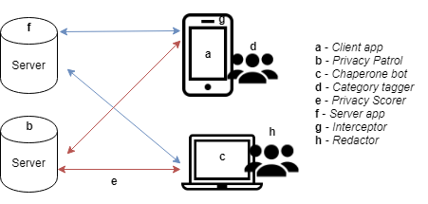
Mitigation Techniques

Slide 10
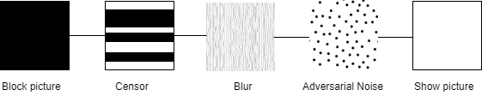
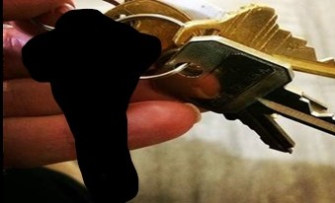
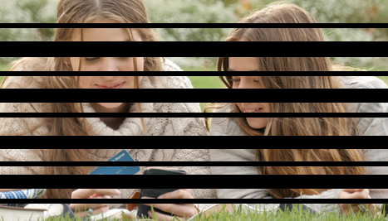
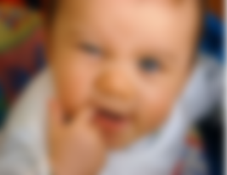
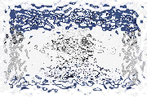
Redaction Spectrum

Slide 11
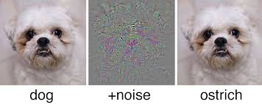
Adversarial Noise Example

Slide 12

VIPERLib Project
Create object detection model
Implement Redaction Techniques
Establish ViperLib

Slide 13
Additional Tasks
Estimate likelihood an image can be uncovered after redaction
How much the object is showing after redaction
Detect or count # of objects in an image
Application design for mitigation techniques
Notes:
These tasks are apart of the effort to quantify privacy

Slide 14
Questions?
OU Data Lab → https://oudatalab.com/
Jasmine DeHart → https://jasminedehart.com/
Christan Grant → http://www.christangrant.com/

